Slide 1
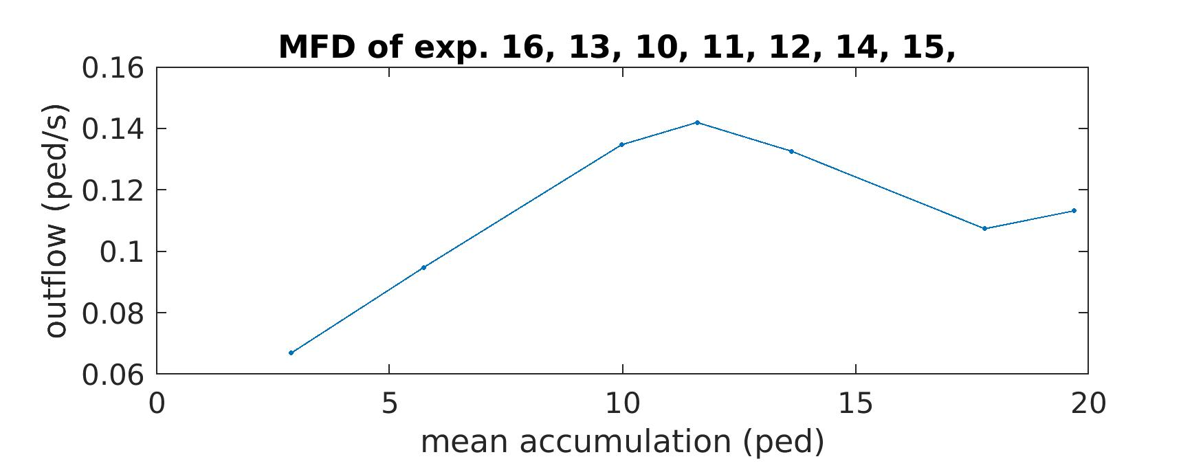

Slide 2
Tradeable Mobility Credits
Practical
DIT4TraM Summer School, 03.07.2024

Slide 3
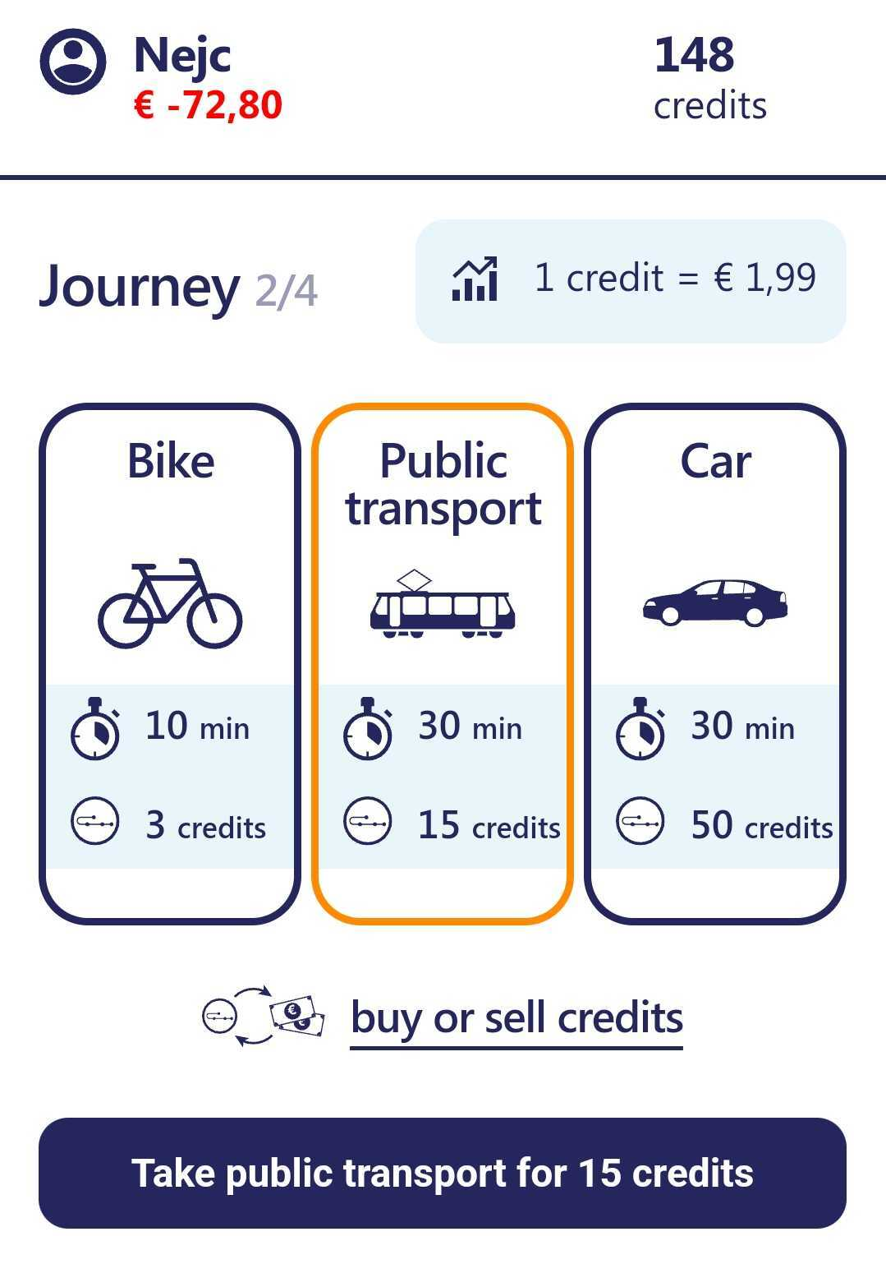
Travel behaviour & Choice modelling
Choice set
Alternatives
Attributes
Attribute levels
Choice

Slide 4


Parameter estimation
$$U_{alt,n}=V_{alt}+ε_{n}$$
$$V_{alt}=β_{X}∙X_{alt}+β_{Y}∙Y_{alt}+…$$
$$P_{alt}=\frac{e^{V_{alt}}}{\sum_{a∈A}{e^{V_{a}}}}$$

Slide 5

Utility function specification
Alternative specific constant
Quadratic, exponential or logarithmic attribute
Interaction effect
$$V_{alt}=ASC+β_{X}∙X_{alt}+…$$
$$β_{X^{2}}∙X_{alt}∙X_{alt}+β_{ln⁡(Y)}∙ln⁡(Y_{alt})$$
$$(β_{X}+β_{XY}∙Y_{alt})∙X_{alt}+β_{Y}∙Y_{alt}$$
$$β_{X}∙X_{alt}+β_{XY}∙X_{alt}∙Y_{alt}+β_{Y}∙Y_{alt}$$

Slide 6
Model output & statistics
Init log likelihood: Model fit if all parameters are 0 (random)
Final log likelihood: Model fit with estimated parameters
Rho-square: Improvement in model fit (from Init to Final)
Account for number of parameters:
Rho-square-bar
AIC (Akaike Information Criterion)
BIC (Bayesian Information Criterion)

Slide 7




Trade-off
Parameter estimates (β) do not say much on their own
Utils as a unit do not mean anything
Using a ratio of two parameter estimates
Utils cancel out
$$\left[\frac{utils}{€}\right]$$
$$=\frac{\left[\frac{utils}{hour}\right]}{\left[\frac{utils}{€}\right]}$$
$$\frac{β_{time}}{β_{cost}}$$
$$=\left[\frac{€}{hour}\right]$$

Slide 8
Practical
Go to MS Teams and download the Jupyter notebook and dataset
Familiarise yourself with Biogeme

Slide 9
Mini-contest
Try out different specifications of the utility function
Interactions, logarithms, quadratic, exponential,…
Keep track of your BIC and report it to me
Winner: Lowest BIC

